Slide 1
2023 GLOBE REGIONAL MEETING FOR ASIA-PACIFIC
COUNTRY REPORT – GLOBE VIETNAM
Linh Phan – Country Coordinator for Vietnam

Slide 2
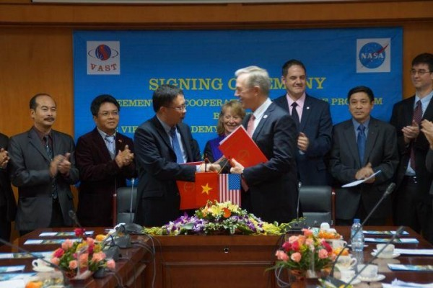
GLOBE VIETNAM
Dec 2015: GLOBE Agreement between Vietnam Academy of Science and Technology (VAST) and NASA
2016: VAST assigned Vietnam National Space Center (VNSC) to implement GLOBE Program in Vietnam
2016-2018: GLOBE Training workshops in Vietnam
2018: GLOBE Regional meeting in Vietnam
GLOBE Agreement signing Dec 2015

Slide 3
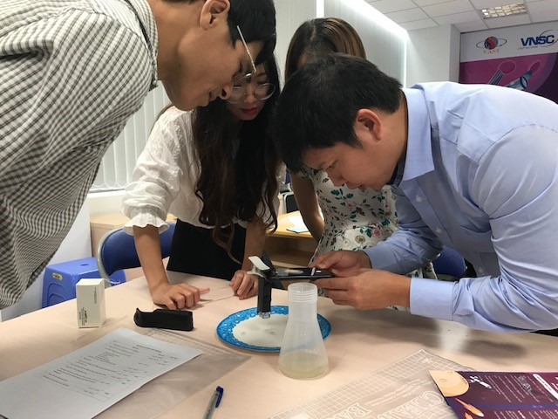
How we implement globe in vietnam
Science Club (volunteer teachers and students)
Centre for Education
Vietnam National Space Center activities
- Space Museum
- Observatory
- Astronomy

Slide 4
COUNTRY AT A GLANCE
School: 93/2835
Students: 3375/2,2mil
Teachers: 218/138.000
Data Entries: 3036

Slide 5
Challenges of globe vietnam
Lack of resources
New National Education program
Extra working hours for the teachers
Language

Slide 6

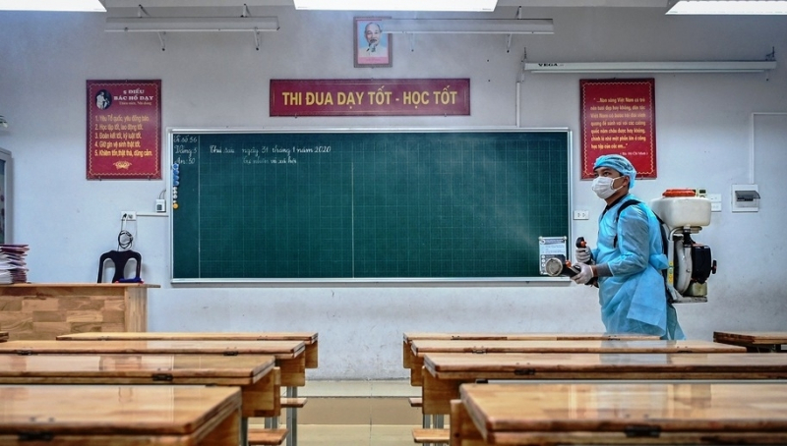
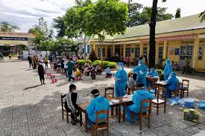

Slide 7
PLAN FOR 2023
Restart GLOBE Program at current active GLOBE schools
Reconnect with inactive GLOBE schools

